Slide 1
CNOS PROJECT
Croitoru Nicolae-Radu
Patlagica Liviu-Gabriel
Group 5312

Slide 2
Braunstein Palace-Computer Network
Braunstein Palace is an architectural monument built at the beginning of the 20th century, more precisely in 1914, and due to its severe degradation state, has been consolidated and restored in 2018-2020.
Activity Profile : Managing Historical Buildings, Monuments and other Landmarks – CAEN code: 9103
The palace will serve both as monument and as library, events hall, art

Slide 3
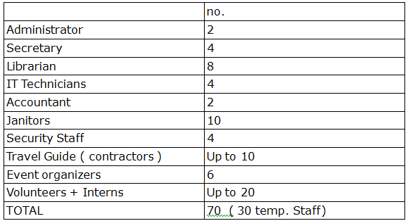
Organisational Structure

Slide 4
Building Analysis
Basement:
One library provided with emergency exits (100 people max)
One bathroom
One elevator
One Hallway
One Media room / Mini Cinema (max 50 People)
One stairway
Ground floor:
One information center
Art Gallery ( 200 p. max)
Coffee Shop
One bathroom
Two stairways
First Floor:
6 reading rooms
One hallway that will host temporary exhibits.
One Library
One bathroom
Two stairways
Second Floor:
6 reading rooms
One hallway that will host temporary exhibits.
Board Room
One bathroom
One elevator
Two stairways
Third floor
Two conference rooms ( 200 P. max )
Two bathrooms
One IT Administration room
One elevator
Two stairways
Attic
One Auditorium (max 150)
Exhibit room
One bathroom
One elevator
One Stairway

Slide 5
Extra
For the Internet access using the Hotspots in the building, Each guest will be provided with either a one-time authentication token based on personal information. The same rule will apply in the case of using the Desktop Computers.
The Staff and Contractors will receive an username and password.

Slide 6
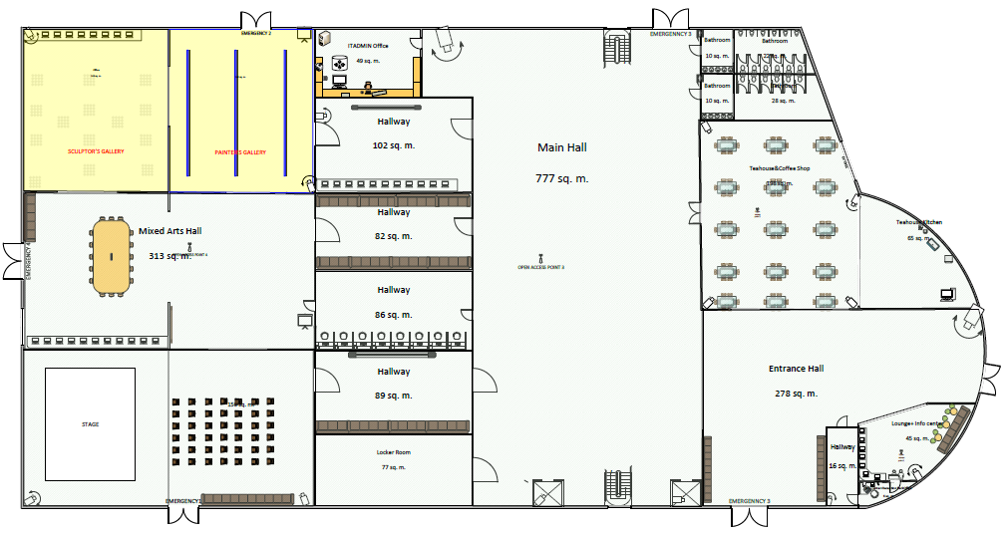
Ground Floor

Slide 7
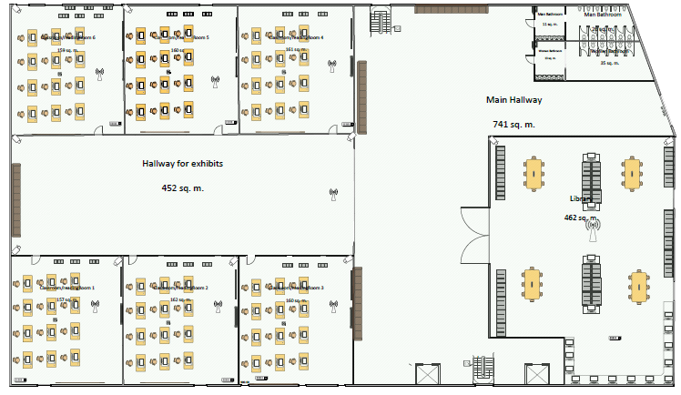
Second Floor

Slide 8
Network analysis
In the present : 13 subnetworks
In the future : Up to 17 subnetworks
In the present : 70 Hosts /Subnet
In the future : 100 Hosts /Subnet
IP CLASS : @1500 hosts overall → B class IP

Slide 9
Subnet address
CLASS B IP: 175.22.0.0
Expected: 13 subnets & a total of 120 hosts/sub
2^{s} > 17 : s=5 ( 32 subnets )
No. of Subnet bits: 5
2^{H}-2 > 120 ; H=11
No of Host Bits: 11 (2046 hosts)

Slide 10
Subnet Mask
5 subnet bits
bin: 11111111.1111111.11111 000.00000000
dec: 255.255.248.0
CIDR: /21

Slide 11
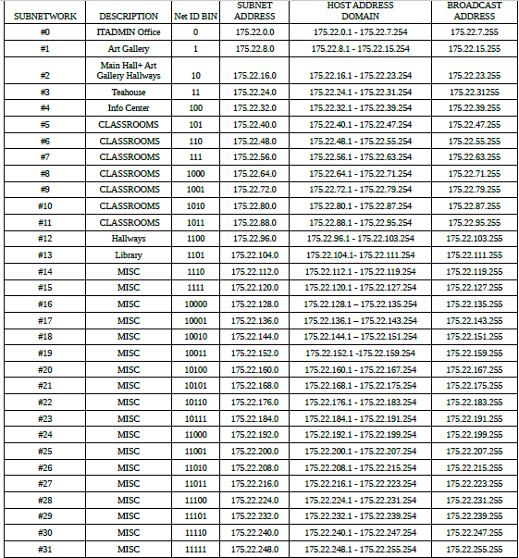
Subnetworks

Slide 12
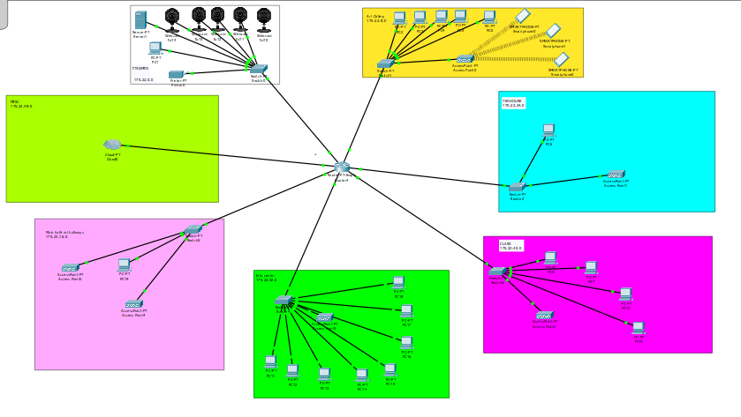
Subnetwork Simulation

Slide 13
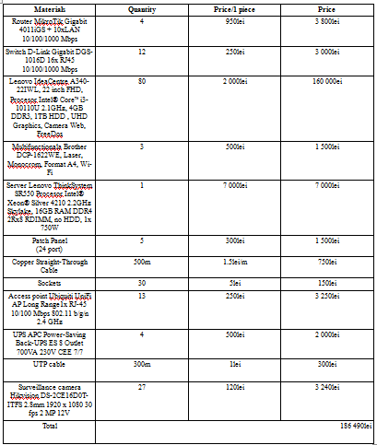
Financial analysis

Slide 14
Other resources
Project Designer:4 000lei/month => 1 000lei
System engineer:3 500lei/month => 875lei
Four workers: 4 x 2 350lei/month =>587lei x 4
D.Estimated HR budget:5225lei
Overall project budget:191 715lei+2 000lei (other expenses) = 193 715lei
Profit: 20%
Final price: 193 715lei+20% = 232 458lei

Slide 15
Thank You!

